Slide 1

Programming One (csc7050)
Aidan McGowan
Enhanced FOR statement
2D Arrays

Slide 2
Enhanced for Statement
The enhanced for statement iterates through the elements of an array without using a loop counter, thus avoiding the possibility of “stepping outside” the array.
The syntax is :
for ( parameter : arrayName ) {
statement(s);
}
where parameter has a type and an identifier (e.g., int number), and arrayName is the array through which to iterate.

Slide 3
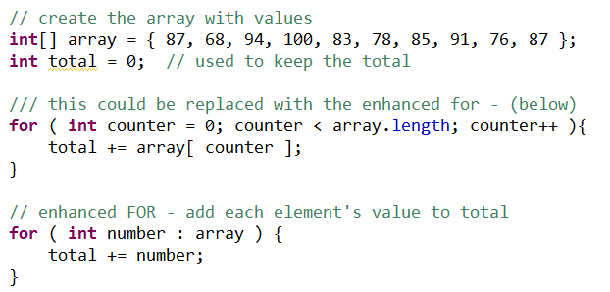
Enhanced for Statement
Also commonly known as the Foreach loop

Slide 4
Enhanced for Statement
The enhanced for statement simplifies the code for iterating through an array.
However, the enhanced for statement can be used only to obtain array elements—it cannot be used to modify elements.
If your program needs to modify elements, use the traditional counter-controlled for statement.

Slide 5
Nested for statement
The nested for loop is a looping construct when a for loop is inside another for loop.
    for( initialization; termination; increment) {
    for( initialization; termination; increment) {
    statement(s)….
    }
    }
outer loop
inner loop

Slide 6
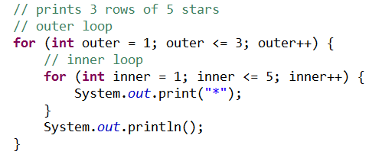

Nested for statement
outer loop
inner loop
The outer loop runs 3 times
The inner loop runs 5 times within each outer loop pass. So that is 15 times in total

Slide 7
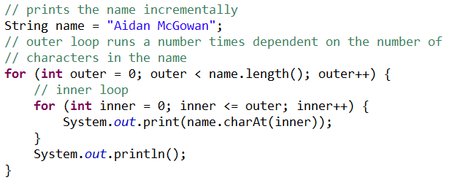
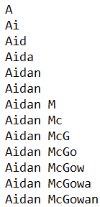
Nested for statement
outer loop
inner loop

Slide 8
Multidimensional Arrays
Multidimensional arrays with two dimensions are often used to represent tables of values consisting of information arranged in rows and columns. To identify a particular table element, we must specify two indices. By convention, the first identifies the element’s row and the second its column. Arrays that require two indices to identify a particular element are called two-dimensional arrays.

Slide 9
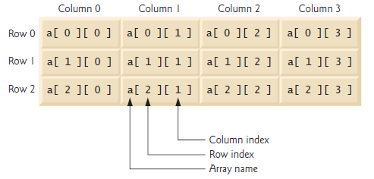
Multidimensional Arrays
A two-dimensional array named a that
contains three rows and four columns (i.e., a three-by-four array). In general, an array with
m rows and n columns is called an m-by-n array

Slide 10
Multidimensional Arrays
Every element in array a is identified by an array-access expression of the form a[row][column];
a is the name of the array, and row and column are the indices that uniquely identify each element in array a by row and column number. The names of the
elements in row 0 all have a first index of 0, and the names of the elements in column 3 all have a second index of 3.

Slide 11

Creating Two-Dimensional Arrays with Array-Creation Expressions
To recreate a table like this ….
we need first to declare a two dimensional array,
with 3 rows and 4 columns.

Slide 12

Creating Two-Dimensional Arrays with Array-Creation Expressions
Declaring the array…
Creates the structure with appropriate default values.

Slide 13
Creating Two-Dimensional Arrays with Array-Creation Expressions
To populate the array each element has its own unique index.

Slide 14
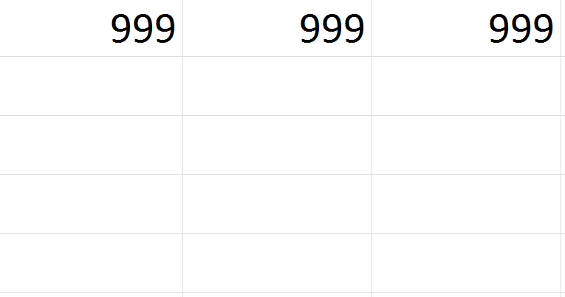
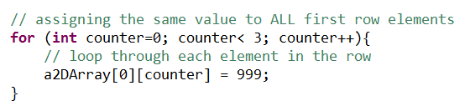
Creating Two-Dimensional Arrays with Array-Creation Expressions
To populate a row using a FOR loop …

Slide 15

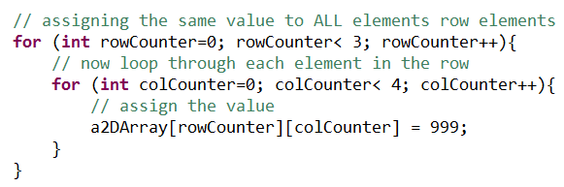
Creating Two-Dimensional Arrays with Array-Creation Expressions
To populate all elements using a nested for loop …
Notes:
Note : altered from original

Slide 16
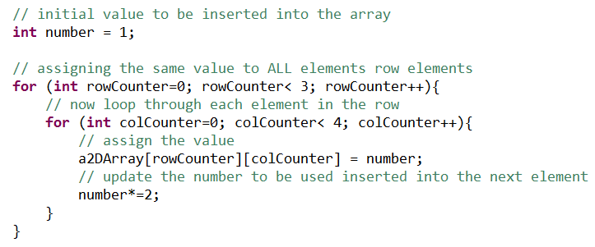
Creating Two-Dimensional Arrays with Array-Creation Expressions

Slide 17
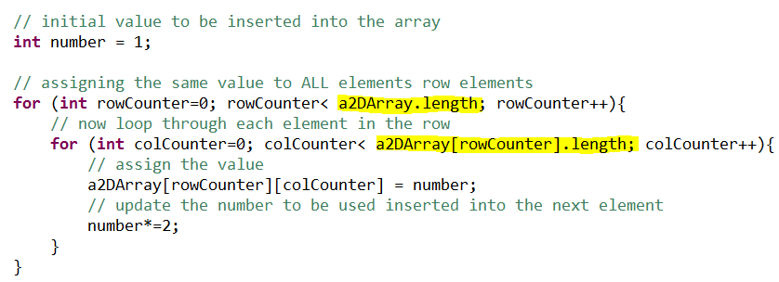
Creating Two-Dimensional Arrays with Array-Creation Expressions
This is better ! You can’t be sure that the array will always be 3*4 so best to use a more generic approach
Refers to the number of rows
Refers to the number of elements in the row

Slide 18
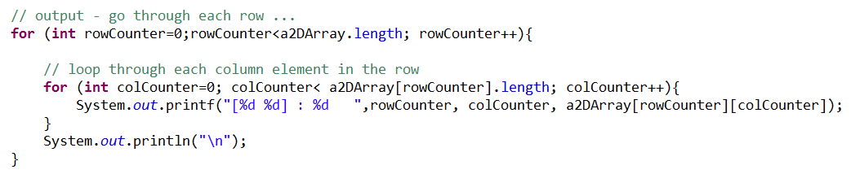
Creating Two-Dimensional Arrays
- output all elements to screen
Similar to approach to fill the elements – using a nested for loop

Slide 19
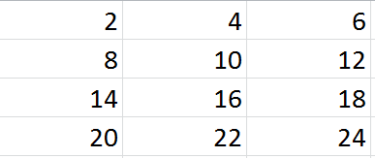
2D Array – exercise
Create a 2D Array with the following contents... Use a nested FOR loop to populate the array. Output the array contents to screen.
Notes:
int[][] myA = new int[4][3];
int num =2;
for (int outer=0; outer<myA.length; outer++){
for (int inner=0; inner<myA[0].length; inner++){
myA[outer][inner] = num;
num+=2;
}
}
for (int outer=0; outer<myA.length; outer++){
for (int inner=0; inner<myA[0].length; inner++){
System.out.print(myA[outer][inner] +" ");
}
System.out.println();
}

Slide 20

Sorting an array – bubble sort
In the bubble sort, as elements are sorted they gradually "bubble" (or rise) to their proper location in the array, like bubbles rising in a glass.
The bubble sort repeatedly compares adjacent elements of an array. The first and second elements are compared and swapped if out of order. Then the second and third elements are compared and swapped if out of order.
This sorting process continues until the last two elements of the array are compared and swapped if out of order.

Slide 21

Sorting arrays – bubble sort
When this first pass through the array is complete, the bubble sort returns to elements one and two and starts the process all over again. So, when does it stop? The bubble sort knows that it is finished when it examines the entire array and no "swaps" are needed (thus the list is in proper order). The bubble sort keeps track of the occurring swaps by the use of a flag.

Slide 22
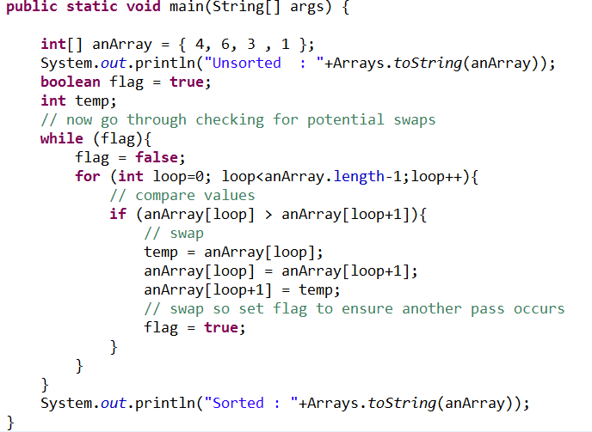
Sorting arrays – bubble sort in action

Slide 23

Don’t reinvent the wheel

Slide 24
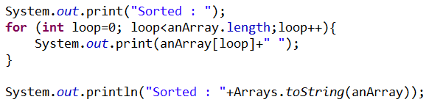
Don’t reinvent the wheel – Arrays class
Both of these functions do the same thing! But the Java API provides the toString() method for Arrays. Which is an alternative to you having to write the functionality from scratch.

Slide 25
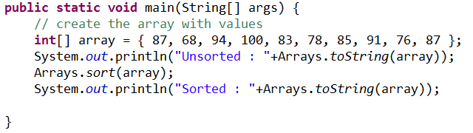
Don’t reinvent the wheel – Arrays class
All the code from the pervious example (Bubble sort) could have been replaced by this….

